Slide 1


Design approaches for
Soft hand wearable robots
Research Overview
Byungchul Kim
Advisor: Prof. Kyu-jin Cho
Experience
Sep. 2020 – Present | Postdoc researcher Soft Robotics Research Center (SRRC) Seoul National University
Education
bc-kim.github.io
Mar. 2014 - Aug. 2020 | Ph.D. in Mechanical Engineering Seoul National University, Seoul, Korea Advisor: Prof. Kyu-Jin Cho
Mar. 2012 - Feb. 2014 | M.S. in Mechanical and Aerospace Engineering Seoul National University, Seoul, Korea
Mar. 2008 - Feb. 2012 | B.S. in Mechanical and Aerospace Engineering Seoul National University, Seoul, Korea
Notes:
Hello.
I am a postdoctoral research fellow at Seoul National University and my name is Byungchul Kim.
This presentation is for introducing my researches conducted in my ph.d. degree and postdoc period.
Also this video only explains all contents briefly, so please look for my personal homepage for more details.
You can access the site using a QR code.

Slide 2
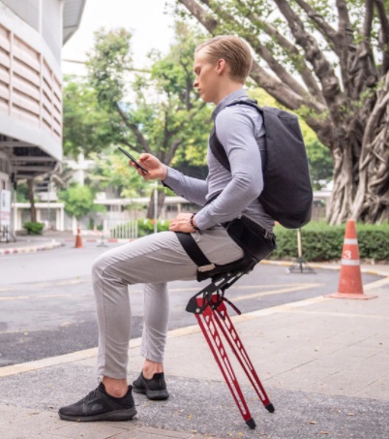
Important things in the wearable robot?
Imagine a ‘wearable chair’ for the non-disabled people
LEX BIONIC CHAIR
What should be considered?
EMG level at the leg
Assist various sitting postures
Well fit to the user
Pressure at the skin
Comfort
Weight
Appearance
Functionality
(Electromyography)
Usability
EMG(Muscle activation)
“Astride Bionix,” LEX BIONIC CHAIR, accessed Oct. 17, 2021, https://astride.io
Notes:
Before explaining my research, I would like to point out an important point when developing wearable robots. Let's imagine we are developing a wearable chair for non-disabled people.
This device can then be developed with the goal of reducing EMG levels. Here, EMG can be thought as an indicator of muscle activity. Or you can think of how many postures the device can support.
However, our experience developing wearable robots has shown that other factors related to comfort are just as important as factors related to functionality. In this presentation, I would refer the factor related to user convenience as a usability.

Slide 3



Trade-off issue of the hand wearable robots
Versatility of
the human hand
Hand plays various roles in a compact size.
Notes:
In the research on hand wearable robots, there is also robot performance related to functionality and usability. As we all know, hands play a variety of roles in our daily life due to their compact size.

Slide 4
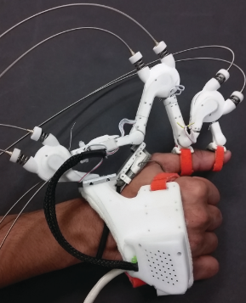
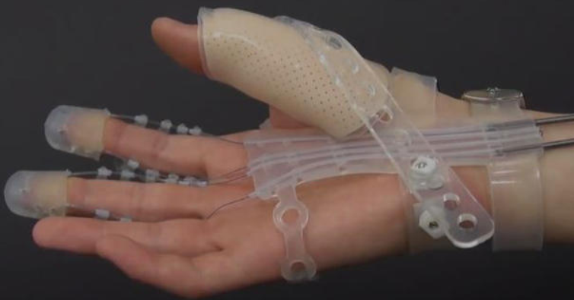
Trade-off issue of the hand wearable robots
Versatility of
the human hand
Functionality vs Usability
in the hand wearable robot
High
DoF
Complex
Agarwal et al, 2017
Find the
optimal point
Hand plays various roles in a compact size.
Low
DoF
Simple
Kang et al, 2019
Notes:
Therefore, it is difficult to satisfy both factors related to the functionality and usability. For instance, when we design the hand wearable robots, using many motors increases the robot versatility but also makes the robot complex. On the other hand, if we use less actuator, we cannot assist various postures, but the robot can be simple.

Slide 5
Contents
Introduction
Trade-off issues of the hand wearable robots
Number of actuators
The use of under-actuation mechanism
The stiffness of the robot components
Sensors at the wearing part
Conclusion
Notes:
For this reason, I have studied several approaches to solve this trade-off between robot functionality and usability that exists in the wearable robot studies. I would like to introduce existing trade-off issues exist in the hand wearable robot researches.

Slide 6
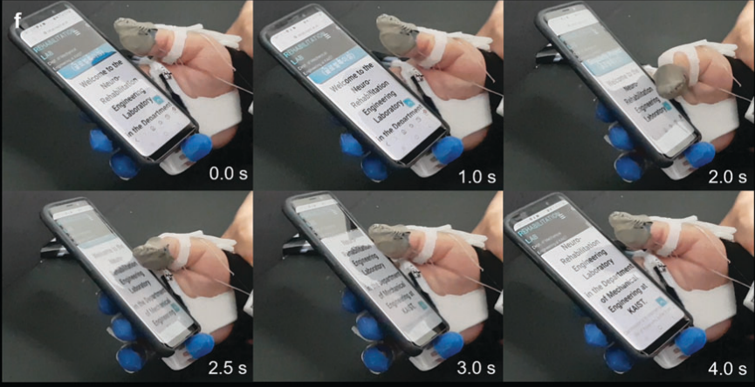
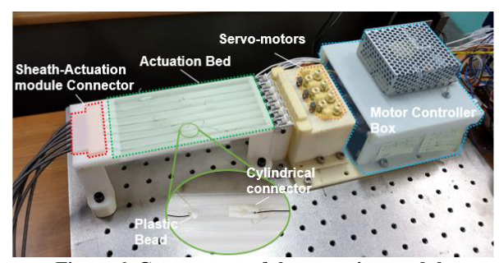
Existing trade-off in the hand wearable robots (1/4)
1. Number of actuators (Robot system with lots of actuators)
Dexterous motions
Complicated system
Number of actuators | Lots of actuators | Less actuators
Advantage | Dexterous motions | Simple system
Disadvantage | Complicated system | Limited functions
Kim, D. H., & Park, H. S. (2018). Cable Actuated Dexterous (CADEX) Glove for Effective Rehabilitation of the Hand for Patients with Neurological diseases. IEEE International Conference on Intelligent Robots and Systems, 2305–2310. https://doi.org/10.1109/IROS.2018.8594336
Kim, D. H., Lee, Y., & Park, H.-S. (2021). Bioinspired High-Degrees of Freedom Soft Robotic Glove for Restoring Versatile and Comfortable Manipulation. Soft Robotics, 00(00), 1–11. https://doi.org/10.1089/soro.2020.0167
Notes:
The first issue is related to the number of actuators as explained in the previous slides. When we use lots of actuators, the robot can assist dexterous motions, but the system becomes complicated.

Slide 7
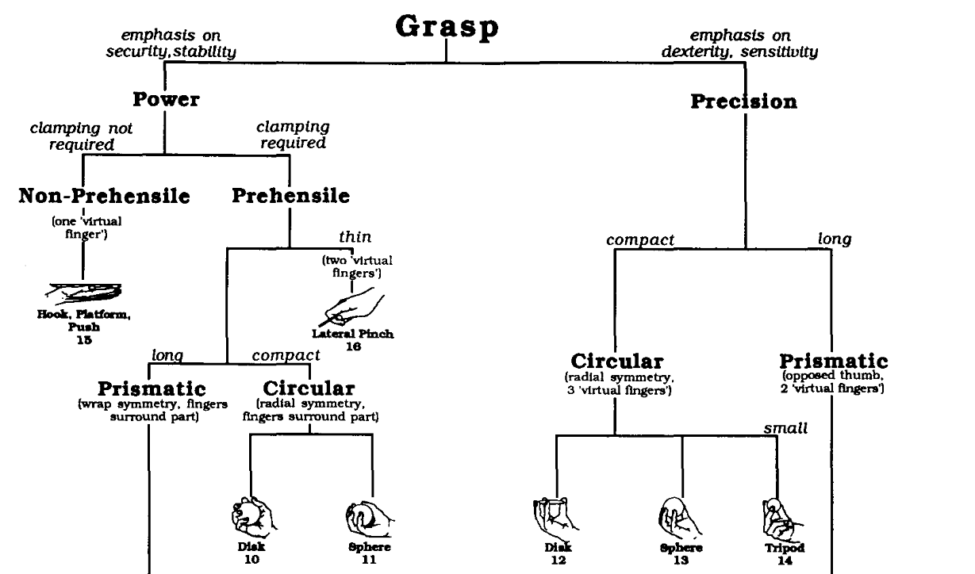
Existing trade-off in the hand wearable robots (1/4)
1. Number of actuators (Robot system with less actuators)
Simple system
Limited functions
Number of actuators | Lots of actuators | Less actuators
Advantage | Dexterous motions | Simple system
Disadvantage | Complicated system | Limited functions
Kang, B. B., Choi, H., Lee, H., & Cho, K. J. (2019). Exo-Glove Poly II: A Polymer-Based Soft Wearable Robot for the Hand with a Tendon-Driven Actuation System. Soft Robotics, 6(2), 214–227.
Cutkosky, M. R. (1989). On Grasp Choice, Grasp Models, and the Design of Hands for Manufacturing Tasks. IEEE Transactions on Robotics and Automation, 5(3), 269–279. https://doi.org/10.1109/70.34763
Notes:
In contrast, if we use less actuators, we can construct the simple robot system. However, it is obvious that the robot will have limited functions.

Slide 8
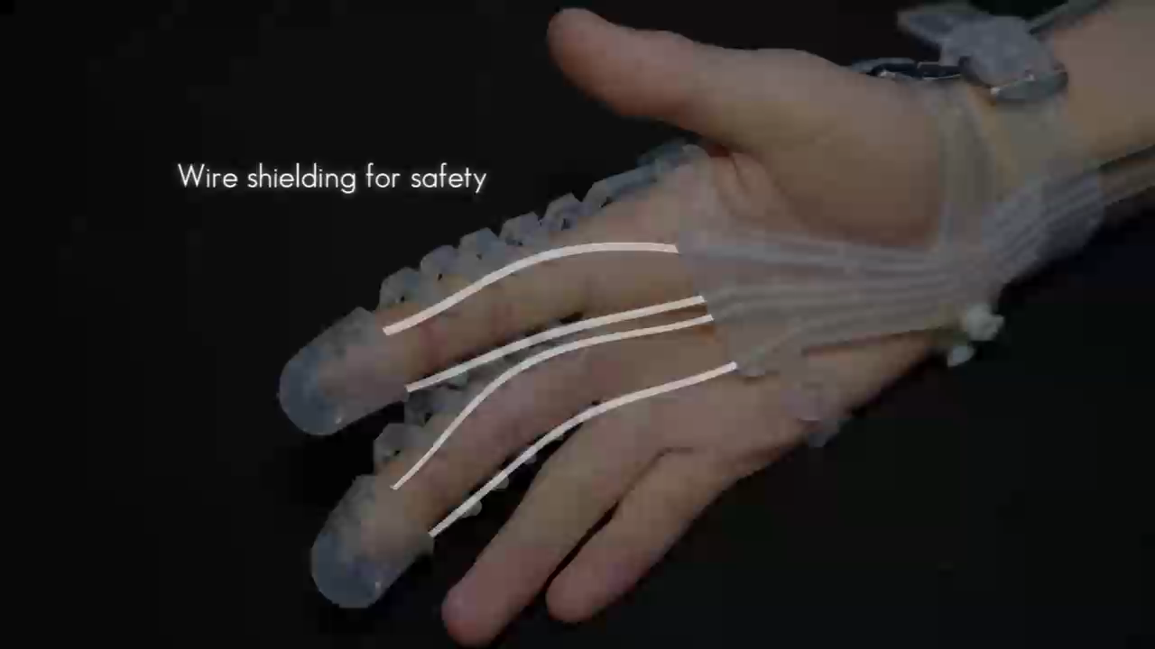
Existing trade-off in the hand wearable robots (2/4)
2. Use of the under-actuation mechanism
Use of TDUM | With TDUM* | Without TDUM
Advantage | Can use less actuators | Simple routing/Less friction Controllable
Disadvantage | Complicated tendon routing High friction | Requires numerous actuators
*TDUM : Tendon-Driven Under-actuation Mechanism
Kang, B. B., Choi, H., Lee, H., & Cho, K. J. (2019). Exo-Glove Poly II: A Polymer-Based Soft Wearable Robot for the Hand with a Tendon-Driven Actuation System. Soft Robotics, 6(2), 214–227. https://doi.org/10.1089/soro.2018.0006
Notes:
For the issue related to the number of actuators, some researchers have proposed tendon-driven under-actuation mechanism. In this presentation, I would refer this mechanism as TDUM.
Interestingly, using this mechanism not only enabled to reduce the number of actuators but also made interesting motion pattern.
As the video shows, when TDUM is used, even one finger is blocked by the external environment, the other finger can continue their motion. This motion pattern is usually named as the adaptability.
Since this adaptable motion stabilizes the grasp performance by increasing the contact points, numerous researchers have utilized TDUM to deal with the trade-off issue related to the actuator number.
However, the use of TDUM also causes trade-off between the functionality and usability.

Slide 9
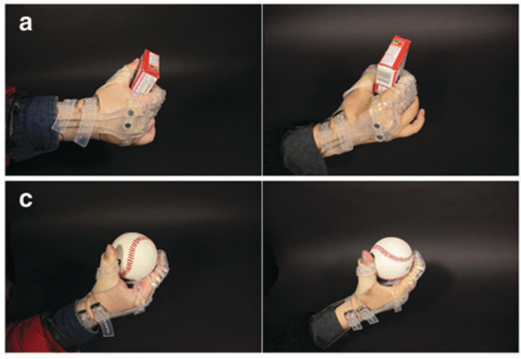
Existing trade-off in the hand wearable robots (2/4)
2. Use of the under-actuation mechanism (When UM is used)
Adaptable to environment with less motor
High friction & complicated tendon routing
Friction occurs
at the curve!
*TDUM : Tendon-Driven Under-actuation Mechanism
Complicated
tendon path
Use of TDUM | With TDUM* | Without TDUM
Advantage | Can use less actuators Adaptive motion | Simple routing/Less friction Controllable
Disadvantage | Complicated tendon routing High friction | Requires numerous actuators
*TDUM : Tendon-Driven Under-actuation Mechanism
Kang, B. B., Choi, H., Lee, H., & Cho, K. J. (2019). Exo-Glove Poly II: A Polymer-Based Soft Wearable Robot for the Hand with a Tendon-Driven Actuation System. Soft Robotics, 6(2), 214–227. https://doi.org/10.1089/soro.2018.0006
Notes:
When we use under-actuation mechanism, we can make adaptive motion with less actuator. However, this mechanism requires complicated tendon routing and causes high friction force.
In addition, because not all joints can be individually controlled, it is not always possible to perform the desired task.

Slide 10
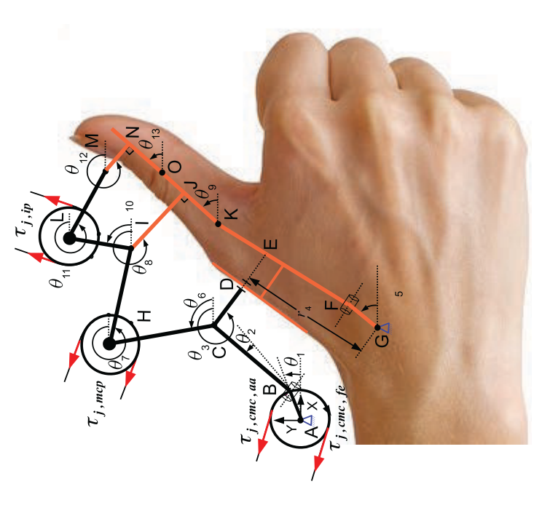
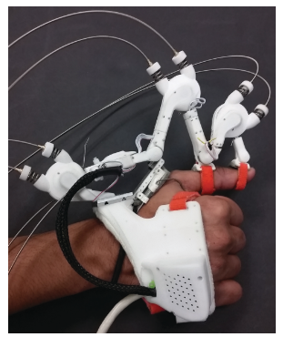
Existing trade-off in the hand wearable robots (2/4)
2. Use of the under-actuation mechanism (When UM is NOT used)
Controllable system
Requires numerous actuators
Use of TDUM | With TDUM* | Without TDUM
Advantage | Can use less actuators Adaptive motion | Simple routing/Less friction Controllable
Disadvantage | Complicated tendon routing High friction | Requires numerous actuators
*TDUM : Tendon-Driven Under-actuation Mechanism
P. Agarwal, Y. Yun, J. Fox, K. Madden, and A. D. Deshpande, “Design, control, and testing of a thumb exoskeleton with series elastic actuation,” Int. J. Rob. Res., vol. 36, no. 3, pp. 355–375, 2017.
Notes:
On the other hand, when we do not use the TDUM, we have to use numerous actuators. However, we can control each joints more accurately. Also, the overall robot design can be simplified because the tendon routing becomes more simple.

Slide 11
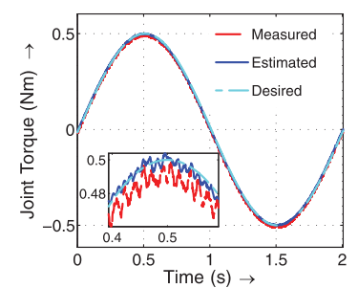
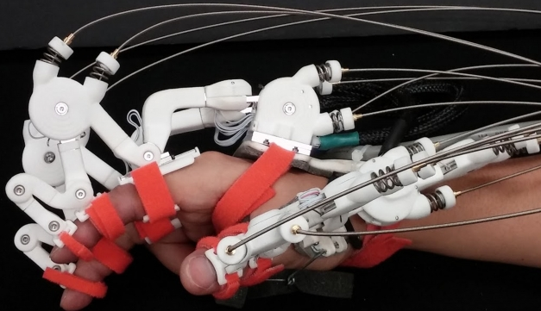
Existing trade-off in the hand wearable robots (3/4)
3. Compliance of the robot body (when rigid component is used)
Accurate force transmission
Bulky/complicated wearing part
Use of TDUM | With TDUM* | Without TDUM
Advantage | Can use less actuators | Simple routing/Less friction Controllable
Disadvantage | Complicated tendon routing High friction | Requires numerous actuators
Stiffness of the robot body | Rigid wearable robot | Soft wearable robot
Advantage | Accurate force transmission | Compact/simple wearing part
Disadvantage | Bulky/complicated wearing part | Inaccurate force transmission
P. Agarwal, Y. Yun, J. Fox, K. Madden, and A. D. Deshpande, “Design, control, and testing of a thumb exoskeleton with series elastic actuation,” Int. J. Rob. Res., vol. 36, no. 3, pp. 355–375, 2017.
Y. Yun et al., “Maestro: An EMG-driven assistive hand exoskeleton for spinal cord injury patients,” Proc. - IEEE Int. Conf. Robot. Autom., pp. 2904–2910, 2017.
Notes:
The third issue is related to the compliance of the robot body. For instance, if we use rigid component as a body of the wearable robot, it is possible to transmit the force more accurately. However, when we use rigid component, we have to align the robot joint with the user`s finger joint. For this reason, the rigid wearable robots becomes bulky and complicated.

Slide 12
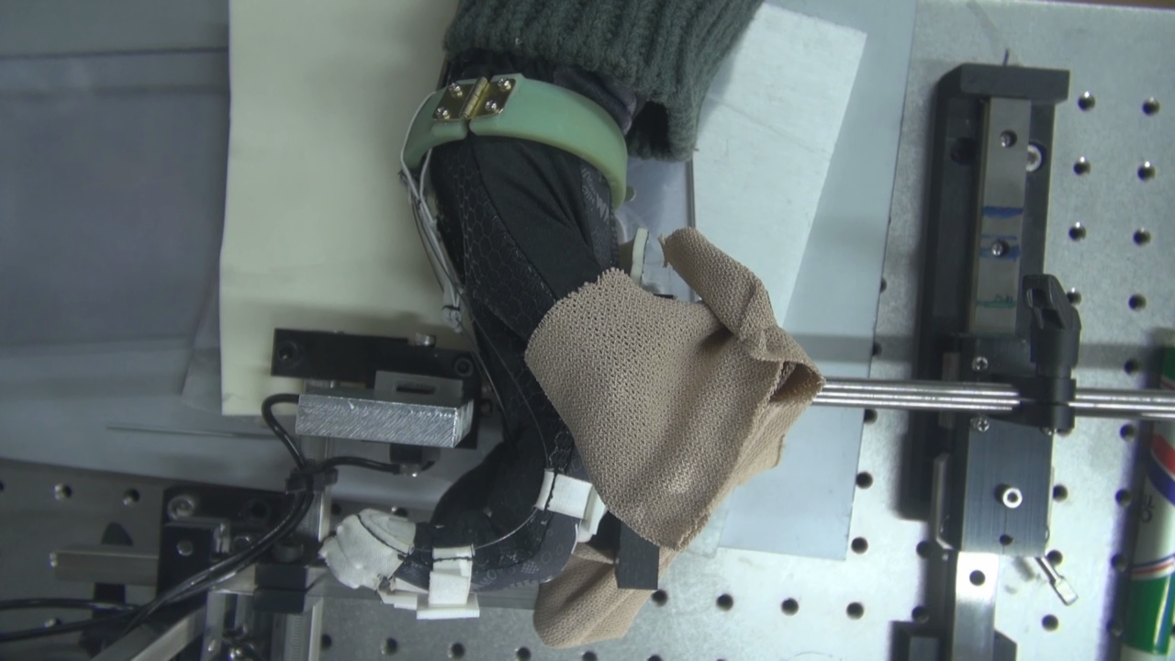
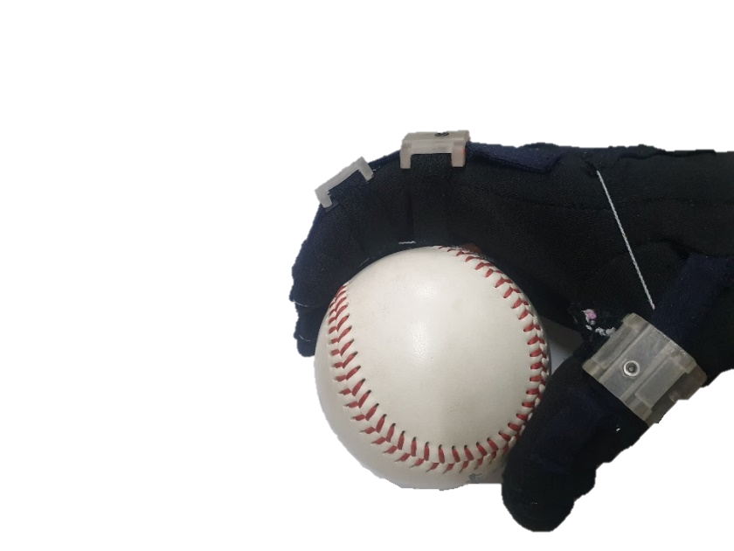
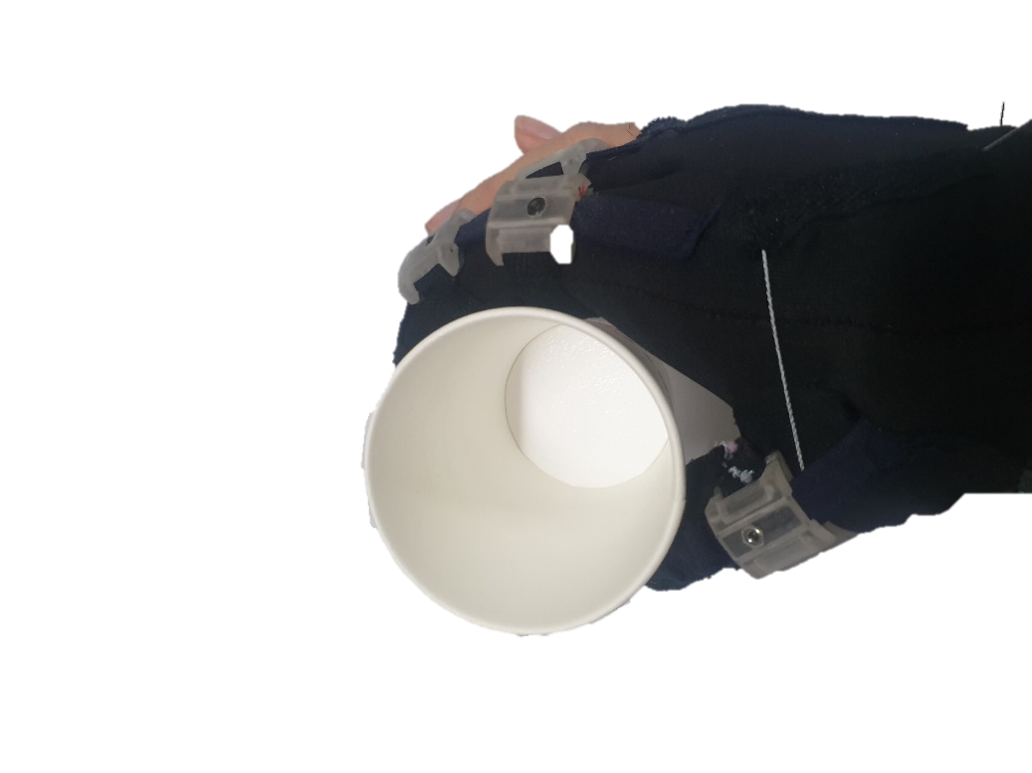
Existing trade-off in the hand wearable robots (3/4)
3. Compliance of the robot body (when soft component is used)
Compact/simple wearing part
Inaccurate force transmission
Elongation of the garment
Stiffness of the robot body | Rigid wearable robot | Soft wearable robot
Advantage | Accurate force transmission | Compact/simple wearing part
Disadvantage | Bulky/complicated wearing part | Inaccurate force transmission
In, H., Kang, B. B., Sin, M., & Cho, K. (2015). Exo-Glove: A Wearable Robot for the Hand With a Soft. IEEE Robotics and Automation Magazine, (March 2015), 97–105.
Notes:
For this reason, numerous researchers have designed the wearable robot with soft component such as garment or silicone.

Slide 13
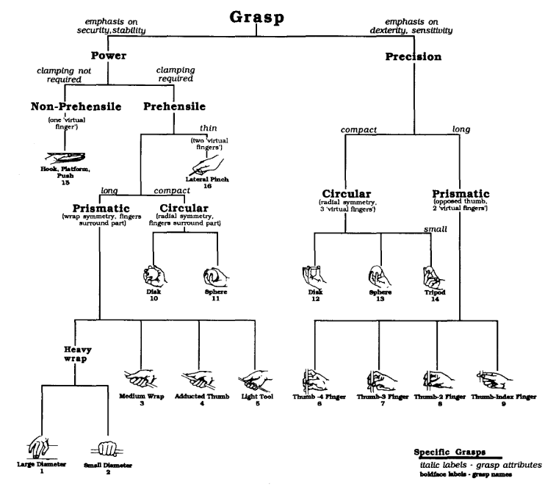
Existing trade-off in the hand wearable robots (4/4)
4. Human state estimation – Required for the robot control
Elongation of the garment
Varying joint stiffness
Various hand postures
Torque (Nm)
Joint angle (deg)
Difficult to estimate the joint angle
Use of sensors at the end-effector | Robots with sensors at the glove | Robots without sensors at the glove
Advantage | Can control the posture accurately | Compact/simple wearing part
Disadvantage | Bulky/complicated wearing part | Feedback control is not possible
M. R. Cutkosky, “On Grasp Choice, Grasp Models, and the Design of Hands for Manufacturing Tasks,” IEEE Trans. Robot. Autom., vol. 5, no. 3, pp. 269–279, 1989.

Slide 14
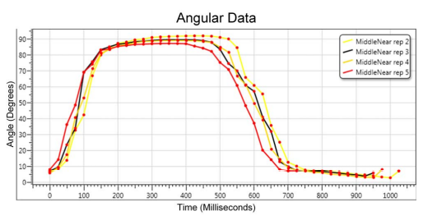
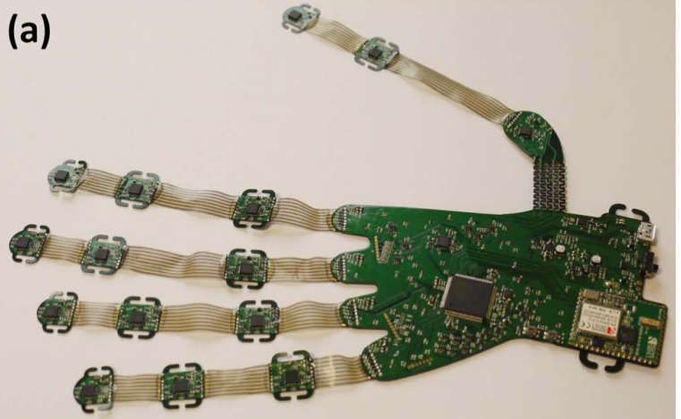
Existing trade-off in the hand wearable robots (4/4)
4. Human state estimation (when multiple sensors are used)
Possible to estimate the joint position
Complicated structure
Use of sensors at the end-effector | Robots with sensors at the glove | Robots without sensors at the glove
Advantage | Can control the posture accurately | Compact/simple wearing part
Disadvantage | Bulky/complicated wearing part | Feedback control is not possible
J. Connolly, J. Condell, B. O’Flynn, J. T. Sanchez, and P. Gardiner, “IMU Sensor-Based Electronic Goniometric Glove for Clinical Finger Movement Analysis,” IEEE Sens. J., vol. 18, no. 3, pp. 1273–1281, 2018.

Slide 15
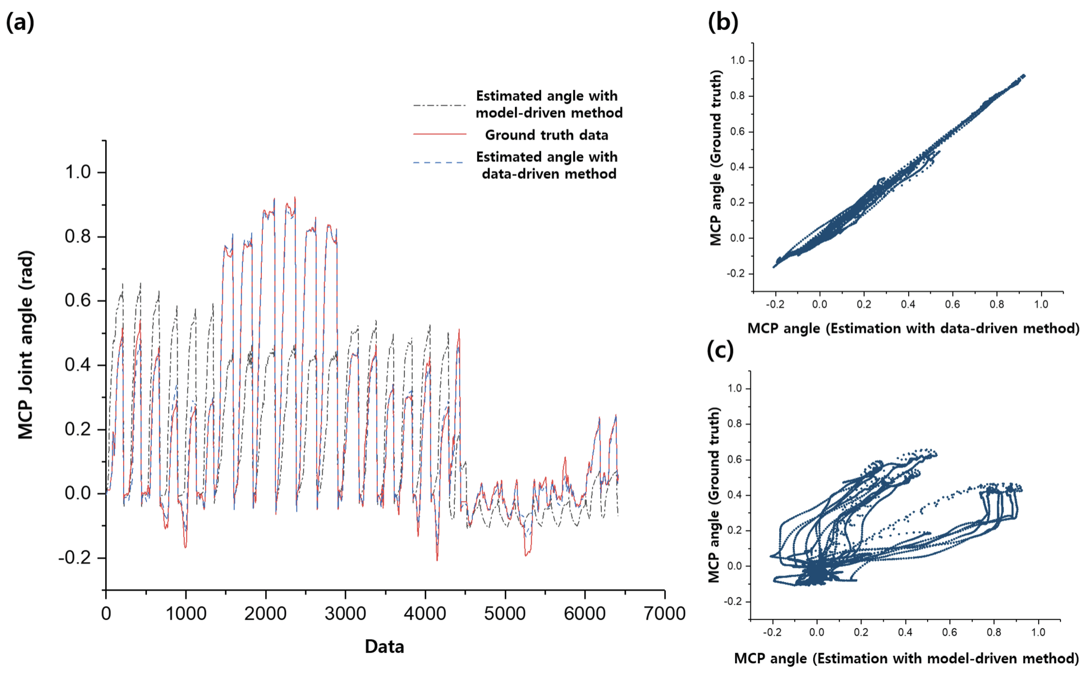
Existing trade-off in the hand wearable robots (4/4)
4. Human state estimation (when less sensors are used)
Simple structure
Difficult to estimate the joint angle
Use of sensors at the end-effector | Robots with sensors at the glove | Robots without sensors at the glove
Advantage | Can control the posture accurately | Compact/simple wearing part
Disadvantage | Bulky/complicated wearing part | Feedback control is not possible

Slide 16
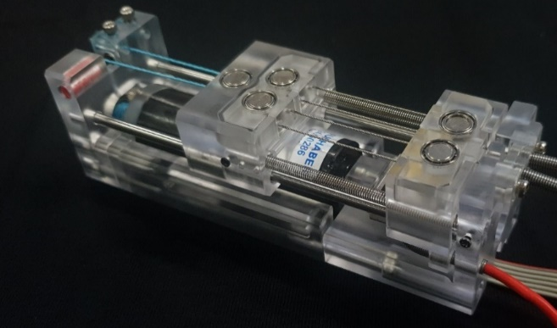
Research overview – Approach for the trade-off issue
Trade-off issue related to under-actuation mechanism
Linear actuator that contains the under-actuation mechanism.
Improves the TDUM performance.
Reduces the complexities of the tendon routing and glove itself.

Slide 17
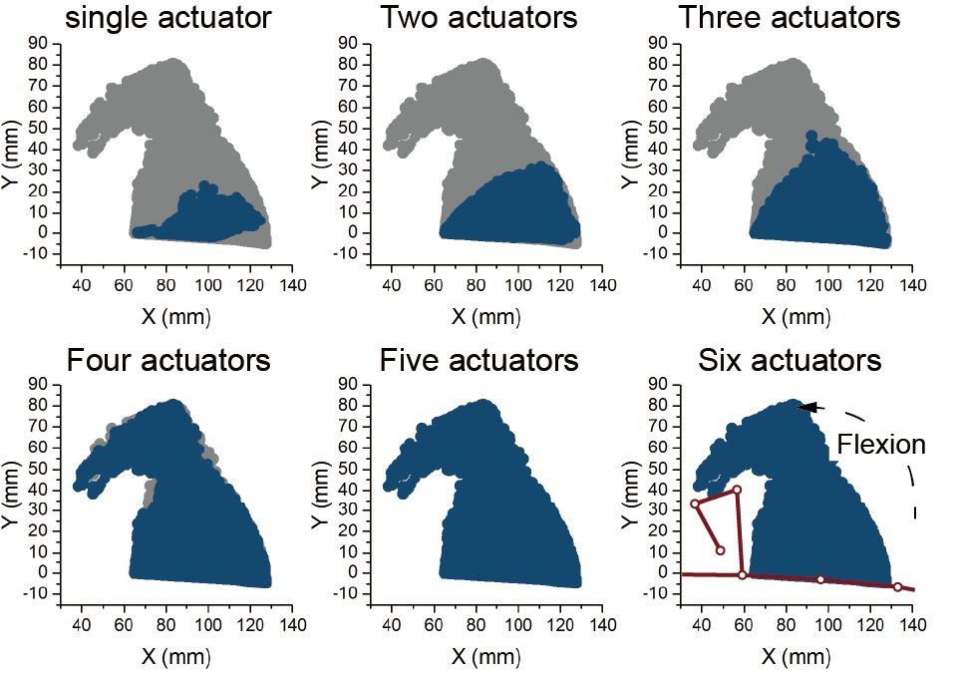
Research overview – Approach for the trade-off issue
Trade-off issue related to under-actuation mechanism
Linear actuator that contains the under-actuation mechanism.
Improves the TDUM performance.
Reduces the complexities of the tendon routing and glove itself.
Trade-off issue related to the number of actuators
The robot application was decided by considering human hand biomechanics.
Minimum number of actuators for the given application was found by simulation.

Slide 18
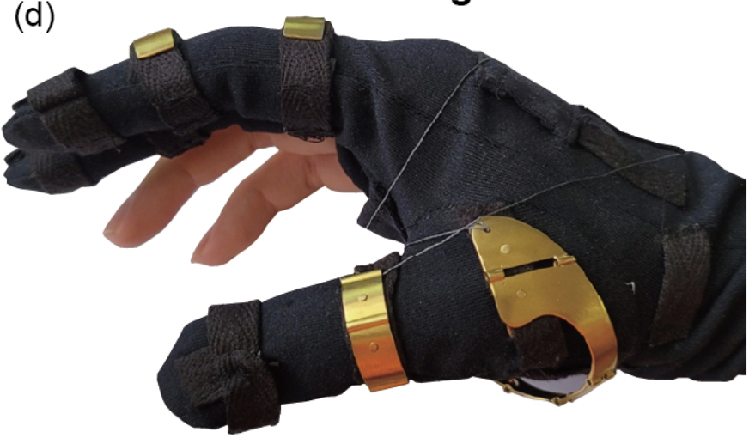
Research overview – Approach for the trade-off issue
Trade-off issue related to under-actuation mechanism
Linear actuator that contains the under-actuation mechanism.
Improves the TDUM performance.
Reduces the complexities of the tendon routing and glove itself.
Trade-off issue related to the number of actuators
The robot application was decided by considering human hand biomechanics.
Minimum number of actuators for the given application was found by simulation.
Trade-off issue related to the stiffness of the robot
Hybrid design using metal and garment.
Improves the force transmission accuracy
Easy fabrication

Slide 19
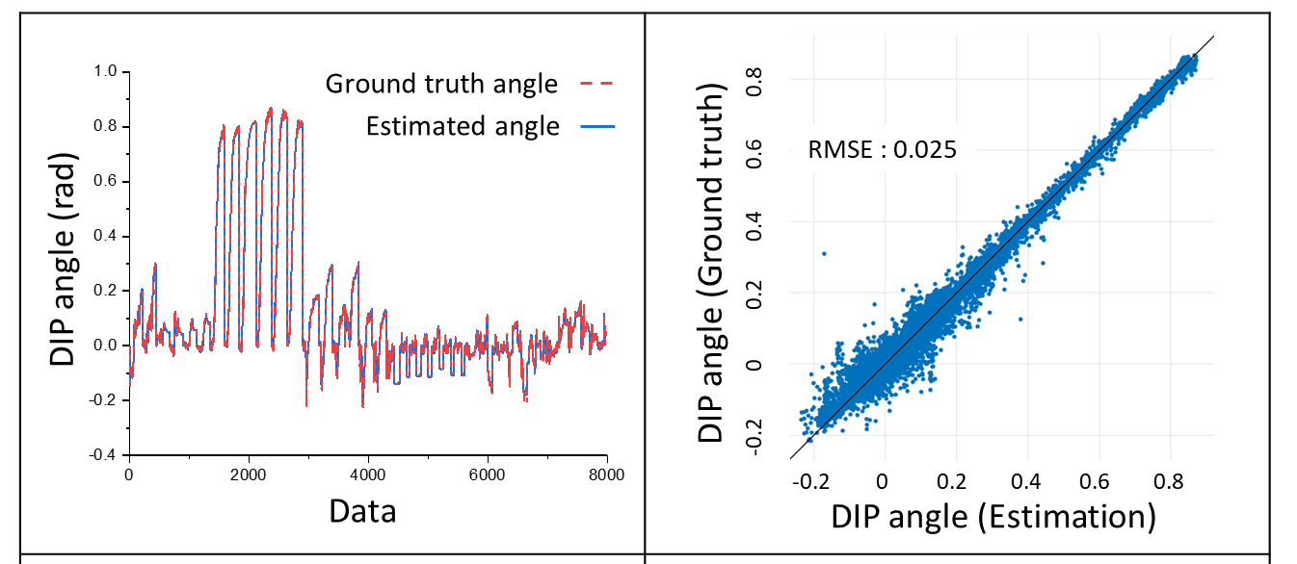
Research overview – Approach for the trade-off issue
Trade-off issue related to under-actuation mechanism
Linear actuator that contains the under-actuation mechanism.
Improves the TDUM performance.
Reduces the complexities of the tendon routing and glove itself.
Trade-off issue related to the number of actuators
The robot application was decided by considering human hand biomechanics.
Minimum number of actuators for the given application was found by simulation.
Trade-off issue related to the stiffness of the robot
Hybrid design using metal and garment.
Improves the force transmission accuracy
Easy fabrication
Trade-off issue related to the sensors at the wearing part
Data-driven state estimation
Joint angle estimation using the motor data

Slide 20
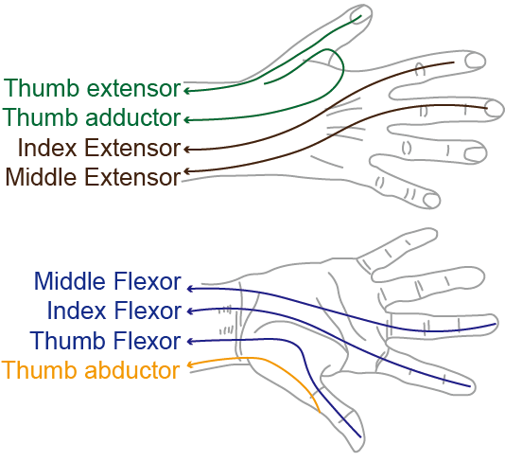
Exo-Glove Shell
Hybrid hand wearable robot with under-actuated tendon transmission
Hand wearable robot that assists the thumb opposition and index/middle finger flexion/extension
Under-actuated tendon transmission for minimized actuators

